Slide 1

Accessing Form Elements-Part 1

Slide 2
Introduction
Forms are the fundamental web elements to fetch information from the website users.
Web forms have different GUI elements like
Text boxes
Password fields
Checkboxes
Radio buttons
dropdowns
file inputs etc.

Slide 3
Selenium encapsulates every form element as an object of WebElement
Provides API to find the elements and take action on them like entering text into text boxes, clicking the buttons, etc
We will see the methods that are available to access each form element.

Slide 4
WebElement, findElement(), findElements()
Web Driver provides the following two methods to find the elements.
findElement() – finds a single web element and returns as a WebElement object.
findElements() – returns a list of WebElement objects matching the locator criteria.
For ex:
WebElement email = driver.findElement(By.id("email")); WebElement password = driver.findElement(By.name("passwd"));

Slide 5
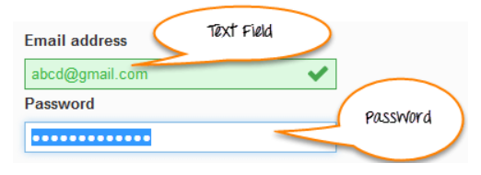
Input Box
It can be:
Text Fields- text boxes that accept typed values and show them as they are.
Password Fields- text boxes that accept typed values but mask them as a series of special characters (commonly dots and asterisks) to avoid sensitive values to be displayed

Slide 6
Locators
The method findElement() takes one parameter which is a locator to the element. Different locators like By.id(), By.name(), By.xpath(), By.CSSSelector() etc. locate the elements in the page using their properties like id, name or path, etc.
You can use plugins like Fire path to get help with getting the id, xpath, etc. of the elements

Slide 7
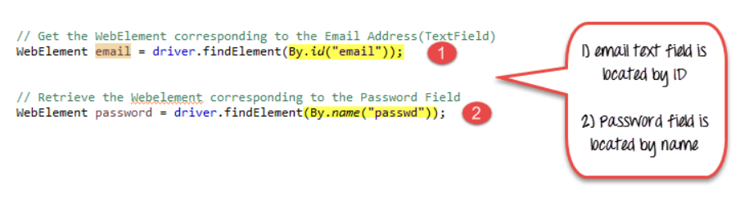
Locators-2

Slide 8
Locators-2

Slide 9
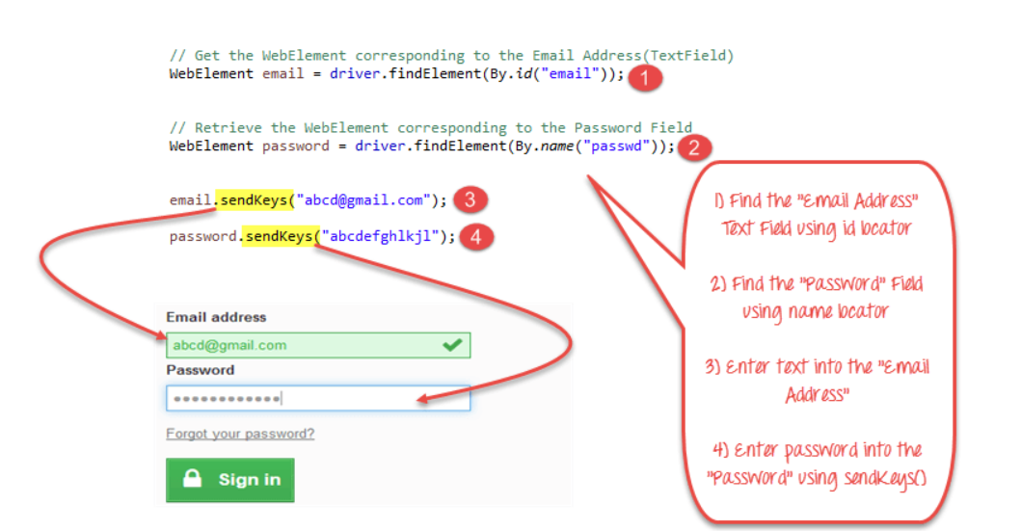
Entering Values in Input Boxes
sendKeys() is the method available to enter values.

Slide 10
Covered Till Now
Find the "Email Address" Text field using the id locator.
Find the "Password" field using the name locator
Enter text into the "Email Address" using the sendKeys() method.
Enter a password into the "Password" field using the sendKeys() method.

Slide 11
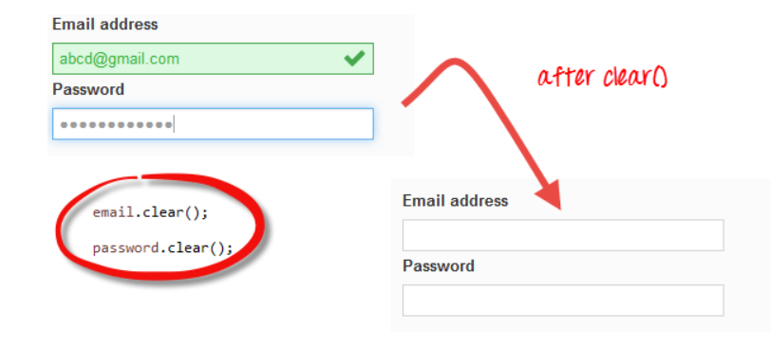
Deleting Values in Input Boxes
The clear() method is used to delete the text in an input box. This method does not need a parameter.

Slide 12
Thanks

